Slide 1
Analyzing Foodborne Disease Outbreaks Over Time
A look into illnesses and more

Slide 2
Group 12
Trina Shores (group leader)
Steven Macapagal
Journey Martinez
Yuan Yao
Heather Nagy
Kenneth Porter

Slide 3
Data on foodborne illnesses

Slide 4
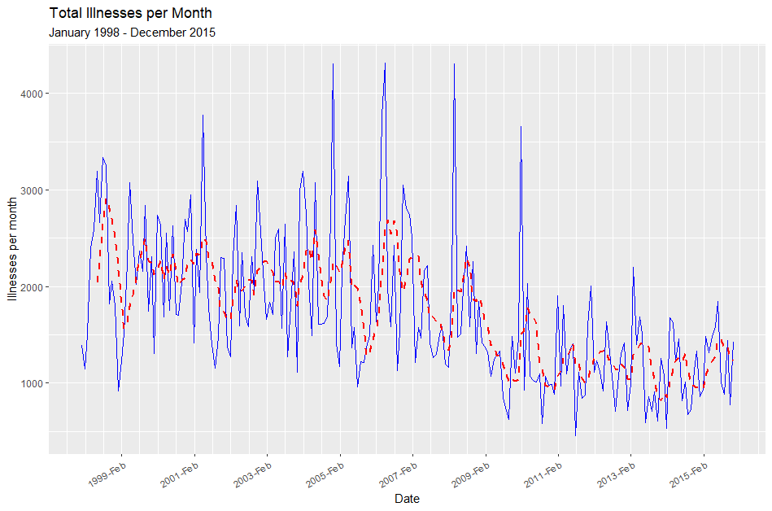
A reminder of what our data look like:
Solid blue line represents the original time series
Dotted red line represents a filtered time series over a 6-month period

Slide 5
Total illnesses per month appear to decline over time and are less variable over time.
Variability is much greater from 1998 to 2008 and decreases from 2009 to 2015. Illnesses also seem to be cyclical.

Slide 6
Our revised goals
How is the rate of foodborne illness changing over time?
Directional trends
Changes in variability
Cyclical trends
Does type of illness or establishment affect the rate of foodborne illness over time?

Slide 7
Selecting and estimating a model

Slide 8
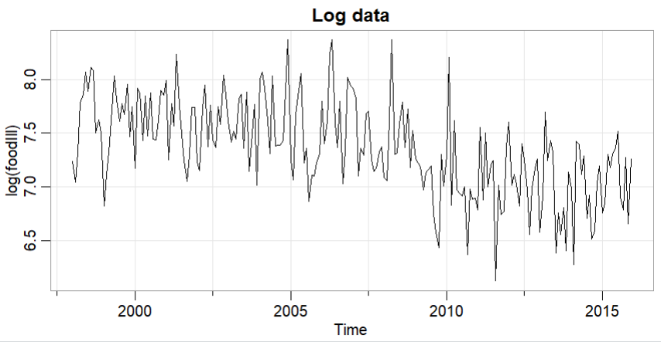
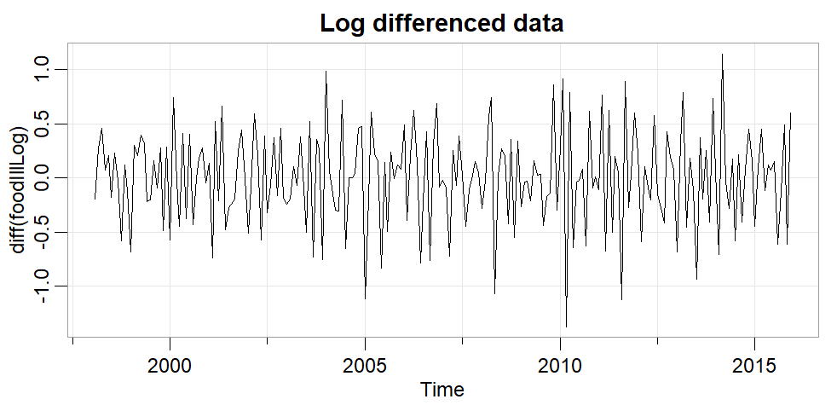
Addressing Nonstationarity in Data
Heteroskedasticity
Because the variability changes throughout the plot, we will log transform the data. Log transformations bring extreme values closer to the rest of the data, removing some variability.
Trend
Because there is a trend, we will then difference the data.

Slide 9
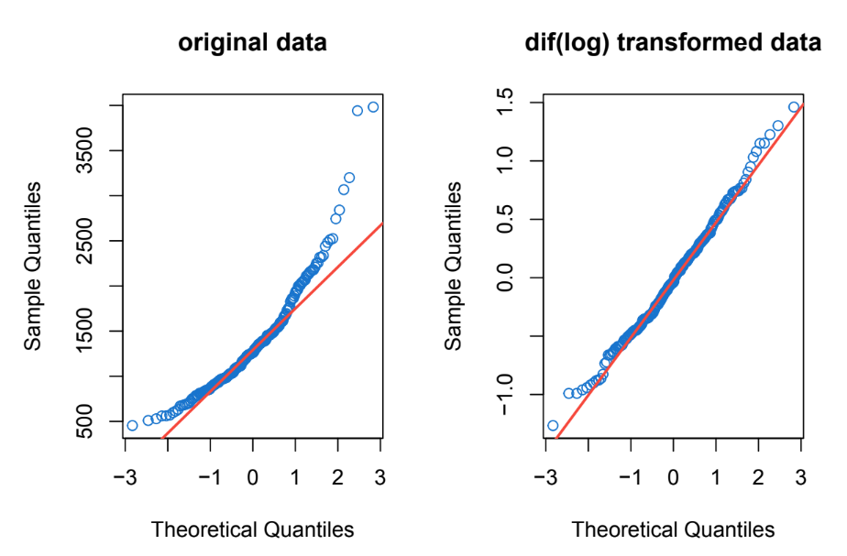
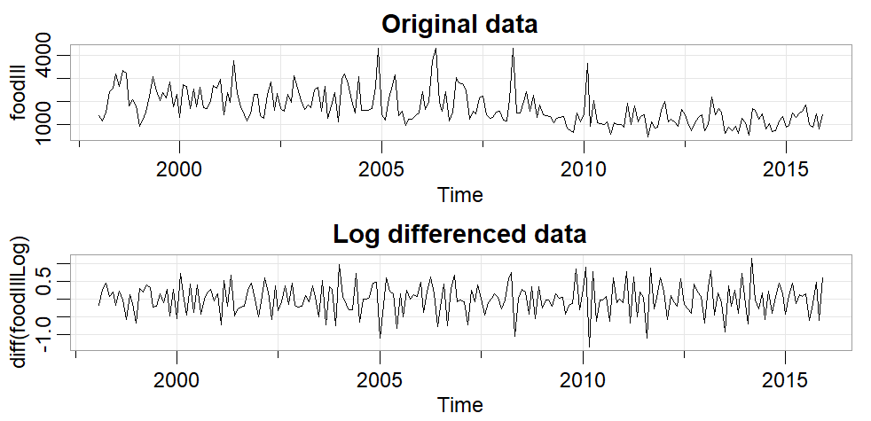
Transforming Data to Stationarity
Log transformed to Normality
First order differencing
Q-Q plot with both transformations shows linearity
Augmented Dickey-Fuller test
p-value = 0.01 < 0.05
Transformed series is stationary
KPSS test
p-value = 0.1, failed to reject Null Hypothesis
Transformed data is trend stationary

Slide 10
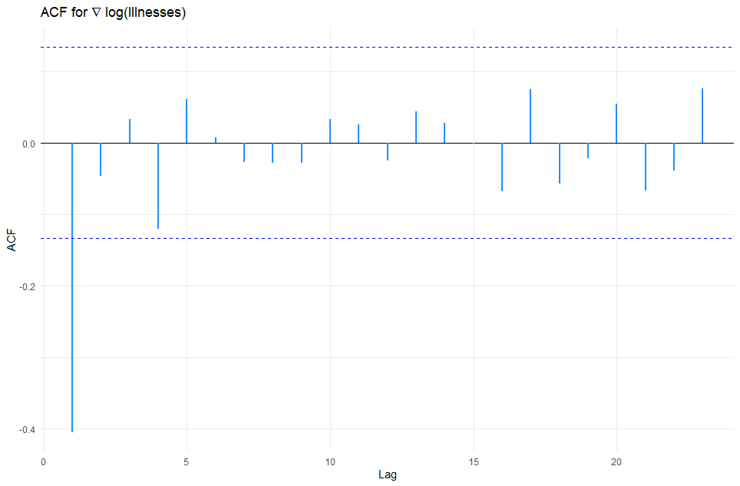
ACF
Only the first lag appears to be significant, while the ACF is not significantly different from zero afterwards.

Slide 11
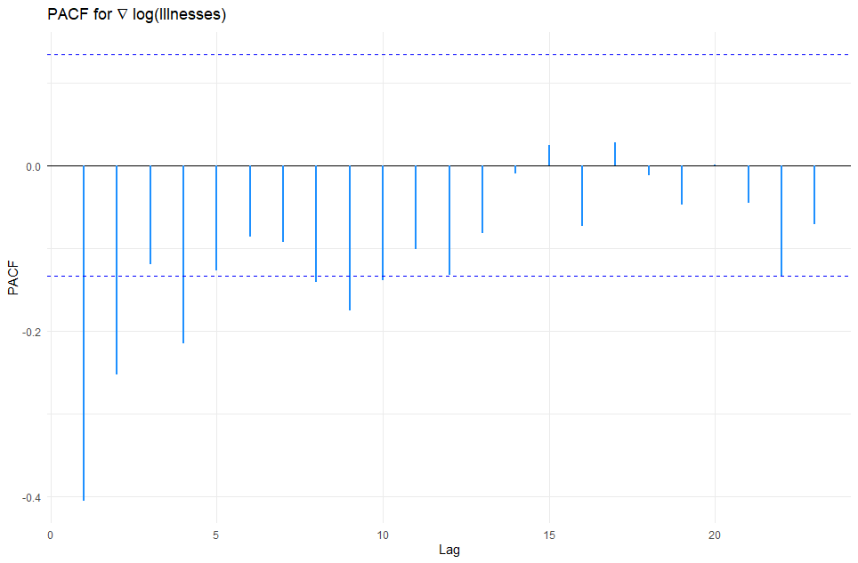
PACF
The partial autocorrelogram appears to tail off over time. The first few lags are significant, and the magnitude of PACF decreases over time.

Slide 12
Model Selection Based on ACF and PACF
We choose MA(1) since only the ACF value for lag 1 was significant while the PACF had multiple significant values

Slide 13
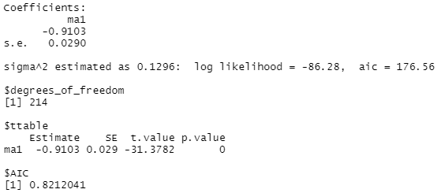


Parameter Estimation of MA(1)
MLE estimation (unconditional least squares) with the sarima function in the astsa library
Using p = 0, d= 0 (using differenced log data) and q = 1 yielded best results
Values converged = > reasonable model
Conditional SS = -1.010483
Unconditional SS = -1.017639
MA(1) term significant

Slide 14
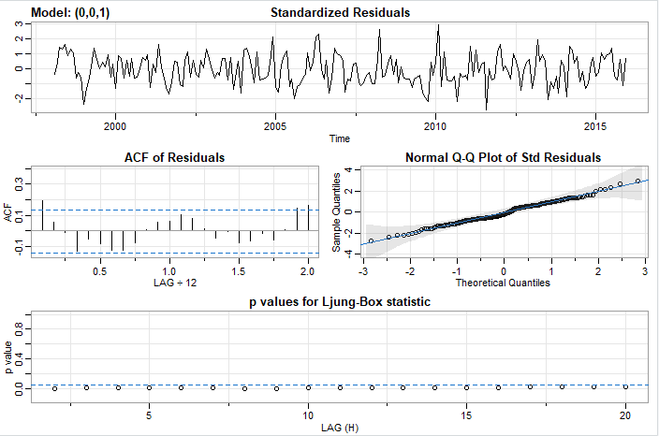
Estimation Output of MA(1)
Scattered, Normally distributed residuals
ACF shows no departure from model assumptions
p-values for Ljung Box are all > 0.05
Residuals are correlated!

Slide 15
Addition of AR(1) to Model
Based on the results of the Ljung Box plot, we reject the null hypothesis that the residuals are uncorrelated (Q-tests are all significant). Because our residuals are correlated, we know they are not white noise.
To alleviate this, we add an AR(1) term to the model, giving us an ARMA(1,1).

Slide 16
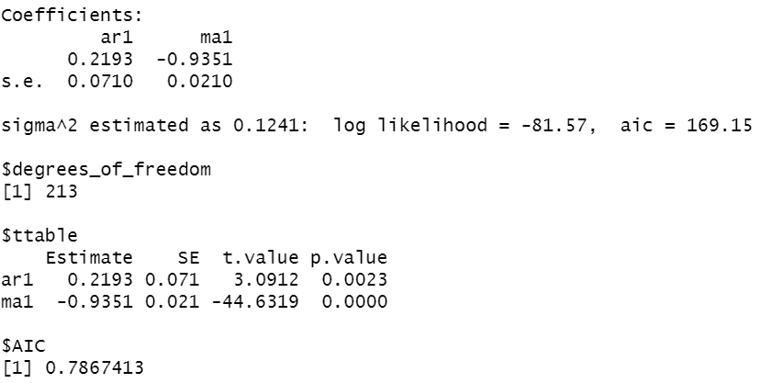
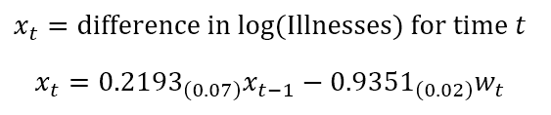

Parameter estimation of ARMA(1,1)
MLE estimation (unconditional least squares) with the sarima function in the astsa library
Using p = 1, d= 0 (using differenced log data) and q = 1 yielded best results
Values converged = > reasonable model
Conditional SS = -1.014162
Unconditional SS = -1.039521
AR(1) and MA(1) terms significant
Smaller AIC and BIC than AR(1) and MA(1) models
Notes:
sarima(diff(log(foodIll)), p = 1, d = 0, q = 1, no.constant=TRUE)
No.constant = TRUE as differencing = 0. This gives us the mean estimate. https://www.rdocumentation.org/packages/astsa/versions/1.15/topics/sarima

Slide 17
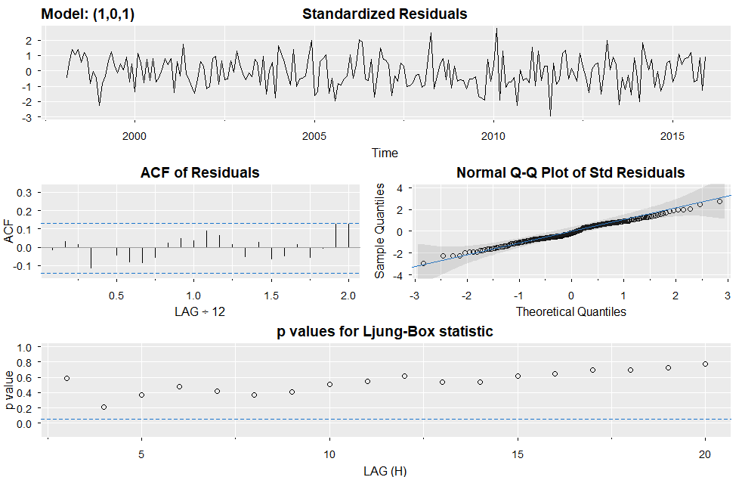
Estimation Output of ARMA(1,1)
Scattered, Normally distributed residuals
ACF shows no departure from model assumptions
p-values for Ljung Box > 0.05
Residuals are uncorrelated
Notes:
https://github.com/nickpoison/astsa/blob/master/fun_with_astsa/fun_with_astsa.md#colors

Slide 18
Future areas of research
Trying to fit an ARIMA model (suggested in prior literature on foodborne illnesses)
Analyze trends based on type of illness and establishment more closely
Forecast data for years after 2015 and hopefully check against CDC data from that same period

Slide 19
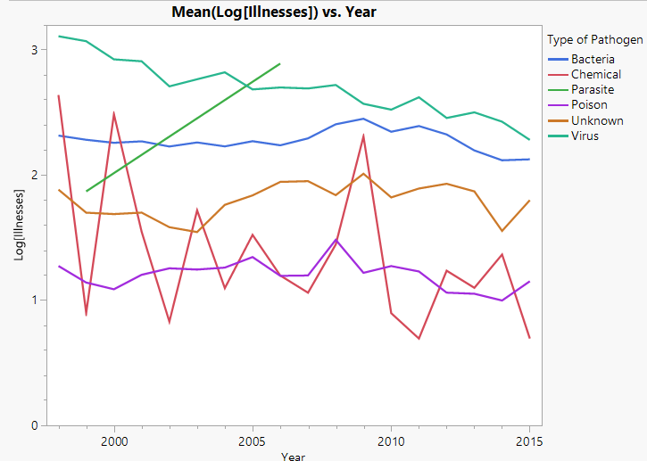
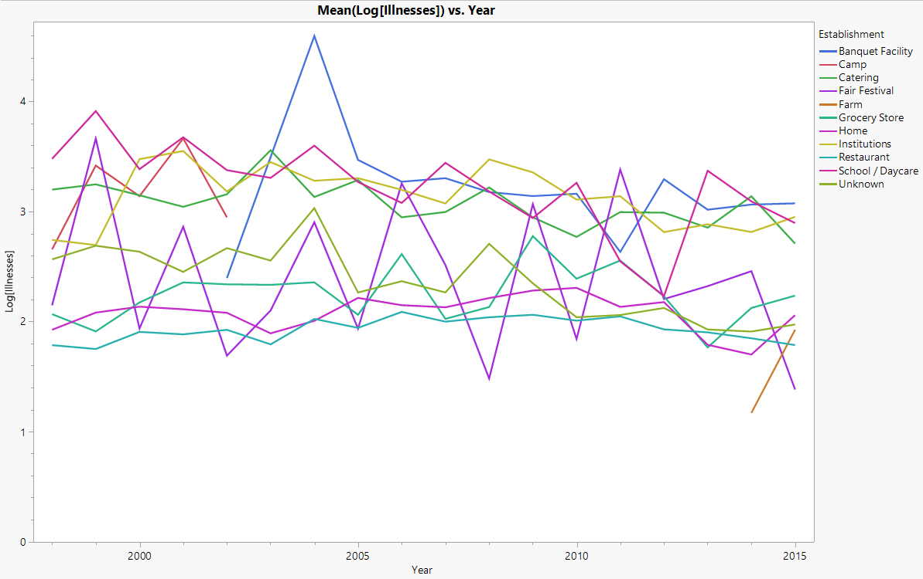
Future Look Preview
Statistical differences between Types
Statistical Differences between Illness Source
Interactions observed between type and illness Source

Slide 20
Questions, comments, suggestions?

Slide 21
Thank you for your
engagement and feedback!

